Slide 1
Angular – State management
Peter Eijgermans peter.eijgermans@ordina.nl

Slide 2
What is State?
Application state is the entire memory of the application.
In simple terms, application state is composed of:
Data received by API calls
Data received via websockets (server push solution)
User inputs
Presentation UI state
Application preferences
etc…

Slide 3
Why State management?
Managing state in an App is hard
and becomes quickly tedious
with no clear overview what happens where.

Slide 4
How to communicate between components?
Notes:
As you are well aware, an Angular application is typically made up of many components. Each of these components has its own state and has no awareness of the state of the other components. In order to share information between parent-child components, we use @Input and @Output decorators. However, this approach is practical only if your application consists of a few components, as shown below.

Slide 5
Don’t use @Input and @output
Use Redux !

Slide 6
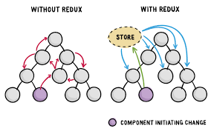
Solution: Global Store
Notes:
Managing state in a Single page Javascript is hard and becomes quickly tedious with no clear overview what happens where.

Slide 7
Wat voor problemen lost een Global Store op?
De store dient als een client-side cache om herhaalde Ajax-calls te voorkomen
- Een Globale store lost het probleem op tussen component interactie
Globale store kan tijdelijke ‘UI state’ opslaan (als je navigeert tussen views)
Wijziging van tijdelijke gegevens aan de clientzijde door meerdere actoren (de server en/of de eindgebruiker). De server via via websockets.

Slide 8
What kind of problems does a Store solve?
They provide a client-side cache if needed, to avoid doing repeated Ajax requests
Solve the problem of component interaction
Provide a place to put temporary UI state (when navigating between views)
Allowing modification of client side transient data by multiple actors
(the server and/or the end-user)

Slide 9
Redux is based on 3 principles
1. Single source of truth → the Store!

Slide 10
Redux is based on 3 principles
2. State is immutable
In order to make changes in the state,
you have to dispatch actions
Notes:
It only implies that you are not allowed to change the state directly. In order to make changes in the state, you have to dispatch actions

Slide 11
Redux is based on 3 principles
3. State is modified with pure functions
Called: Reducers
Notes:
It only implies that you are not allowed to change the state directly. In order to make changes in the state, you have to dispatch actions

Slide 12
Architecture

Slide 13
NgRx/Redux

Slide 14


What is NgRX?
NgRx is a state management system that is based on the Redux pattern

Slide 15
Wat voor problemen lost NgRx op?
De store dient als een client-side cache om herhaalde Ajax-calls te voorkomen
- Een Globale store lost het probleem op tussen component interactie
Globale store kan tijdelijke ‘UI state’ opslaan (als je navigeert tussen views)
Wijziging van tijdelijke gegevens aan de clientzijde door meerdere actoren (de server and the end-user)
Is Reactive (Event driven)
Notes:
Reactive programming is a way applications handle events and data flow in your applications. In reactive programming, you design your components and other pieces of your software in order to react to those changes instead of asking for changes.

Slide 16
Pros NgRx?
No more need for tightly coupled components which makes addition of new features easy.
Simpler components since modification logic has been delegated to reducers and effects.
Immutability of state at component level which eliminates loads of bugs.
Easy debugging → @ngrx/store-dev-tools.
helps to improve app performance as each module loads only the parts of the store it requires.

Slide 17
Cons NgRx?
To much Boiler plate (create actions, reducers, effects and entities)
Finding unique names for actions and effects!
Steep learning curve! (Team is less productive in FE)
Easy to make mistakes
Needs Good knowledge of RxJS

Slide 18
Other Solutions than NgRx
- NGXS is modeled after the CQRS pattern, Strongly Typed
- AKITA built on top of RxJS. Simpler to understand
RXJS make use of BehaviorSubjects, Is Simple
Mobx robust but Supports Angular 9, Is Simple

Slide 19
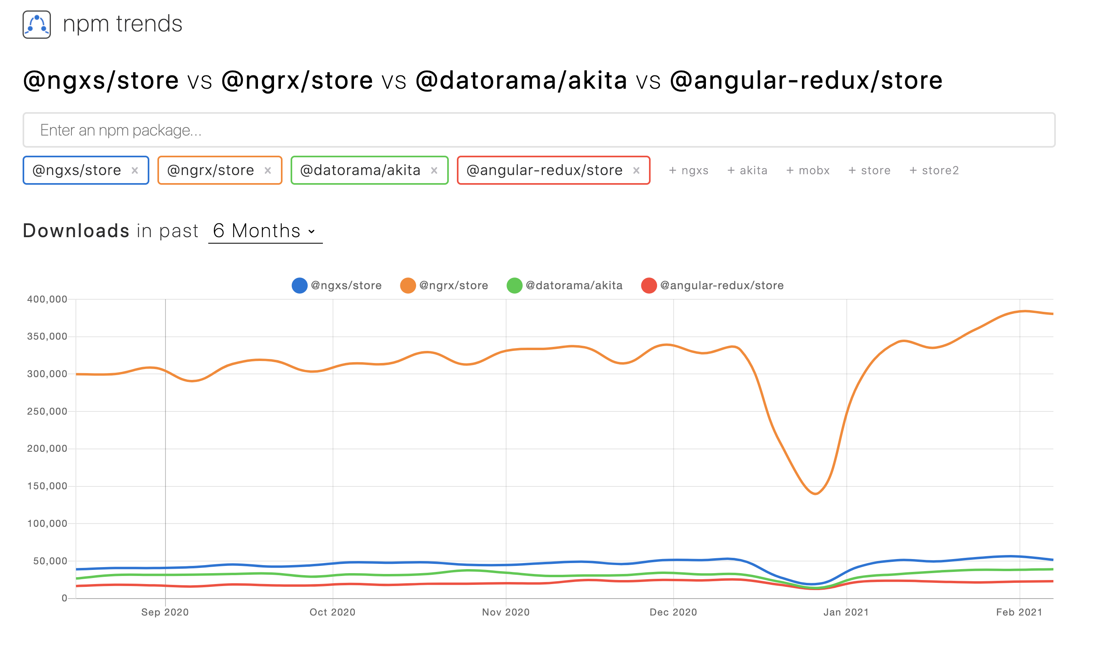
Notes:
https://www.npmtrends.com/@ngrx/store-vs-@ngxs/store

Slide 20
When to choose for NgRx/NgXs?
Ngrx shines the most when you have a lot of external actors that can modify your application, such as a monitoring dashboard.
Incoming data are pushed to your application. And your components should react to those changes instead of asking for changes.
Notes:
Ngrx shines the most when you have a lot of external actors that can modify your application, such as a monitoring dashboard.
In those cases, it is hard to manage all the incoming data that are pushed to your application, and state management becomes hard.
That is why you want to simplify it with an immutable state, and this is one thing that the Ngrx store provides us with.

Slide 21
Fundamental Elements of NgRx
Store
Actions
Reducers
Selectors
Effects
Effects
Selectors

Slide 22
Store
Each component has a reference to the store:
constructor(private store: Store<AppState>) {}
This store reference can be used to:
To dispatch actions to the store
Retrieve the application state via selectors

Slide 23
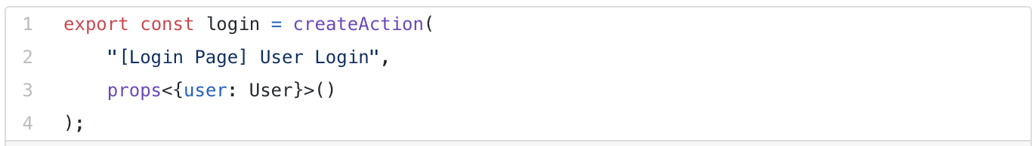
Actions
An action is an instruction that you dispatch to the store
Notes:
Based on the action type, the store decides which operations to execute.
Payload is an optional attribute that will be used by reducers to modify the state.

Slide 24
Reducers
Notes:
Reducers take in two parameters, the current state and the action

Slide 25
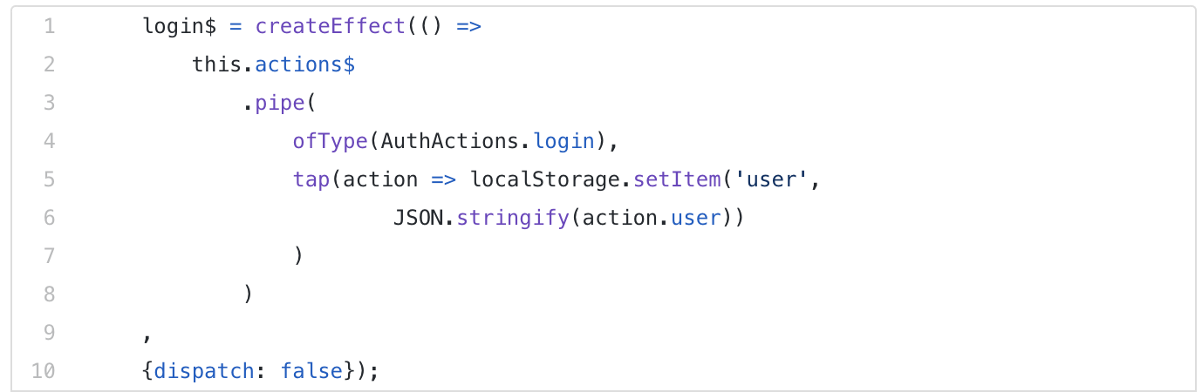
Effects
Allows you to perform side effects when an action is dispatched to the store
Use utility function “createEffect()”:
Notes:
Example!
When a user successfully logs in to an application, an action with type Login Action will be dispatched to the store with the user information in the payload. A reducer function will listen to this action and modify the state with the user information. In addition, as a side effect, you also want to save user information in the browser's local storage. An effect can be used to carry out this additional task (side effect).
Dispatch : false
These effects do not map the incoming action to a new action type, which is why {dispatch: false} config is used.

Slide 26
Selectors
Selectors are functions used for obtaining slices of the store state.

Slide 29
NgRx Entity
export interface Course {
id: string;
name: string;
description: string;
}
import { EntityState } from '@ngrx/entity’;
export interface CourseState extends EntityState<Course> { }

Slide 30
DEMO REDUX !

Slide 31
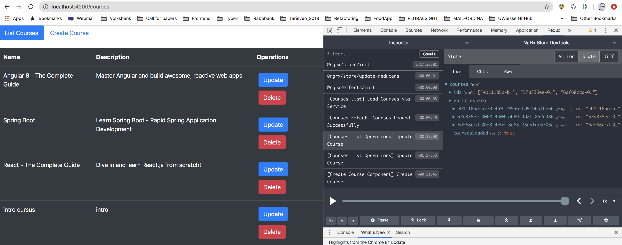
Install Redux Chrome Extension

Slide 32
Start Backend
java -jar {path_to_the_jar_file}/course-1.0.0-SNAPSHOT.jar

Slide 33
NgRx/Redux tutorial
Part 1
https://medium.com/better-programming/angular-getting-started-with-ngrx-75b9139c23eb
Part 2
https://medium.com/better-programming/angular-building-a-crud-application-with-ngrx-40e5f1c0b50c

